Slide 1







Developer Survey Findings
Christoph Lenz
2022-05-12

Slide 2



OUTLINE
Executive Summary
Introduction
Methodology
Results
Visualization – Charts
Dashboard
Discussion
Findings & Implications
Conclusion
Appendix

Slide 3

EXECUTIVE SUMMARY
JavaScript remains Top 1
TypeScript enters Top 5
PostgreSQL gains Top 1
C# dropped out of Top 5
Microsoft SQL Server dropped out of Top 5

Slide 4

INTRODUCTION
Present finding of survey to our Developer Team Leads for
Programming languages
Database technologies
Introduce Dashboard
Discussion of Implications
Appendix
GitHub Job Posting
Popular Languages Salaries

Slide 5

METHODOLOGY
We have used various ways to acquire and prepare the datasets including
Web scraping
APIs
Dashboarding
Please see Appendix for the sources

Slide 6
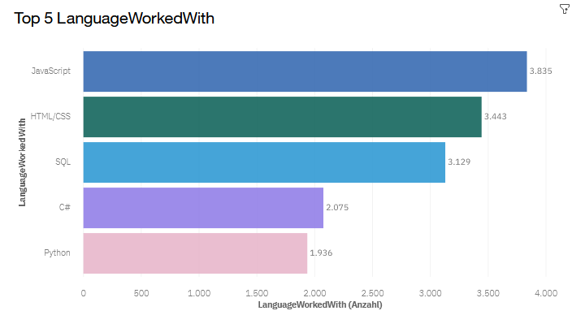
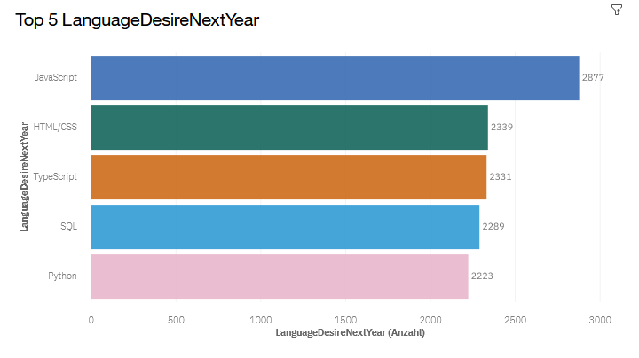
PROGRAMMING LANGUAGE TRENDS
Current Year
Next Year
<Bar chart of top 5 programming languages for the current year goes here.>
< Bar chart of top 5 programming languages for the next year goes here.>

Slide 7
PROGRAMMING LANGUAGE TRENDS - FINDINGS & IMPLICATIONS
Findings
Top 1 is JavaScript
Top 2 is HTML/CSS
Top 3 is SQL
Implications
JavaScript extends its lead
C# drops out of Top 5 and is replaced by TypeScript
SQL drops to Top 4

Slide 8
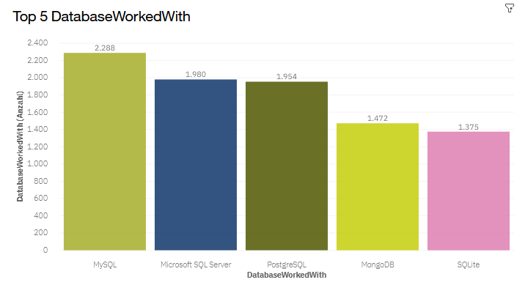
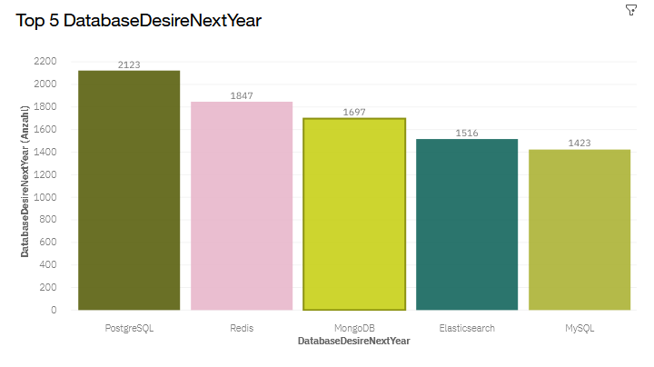
DATABASE TRENDS
Current Year
Next Year
< Bar chart of top 5 databases for the current year goes here >
< Bar chart of top 5 databases for the next year goes here.>

Slide 9
DATABASE TRENDS - FINDINGS & IMPLICATIONS
Findings
MySQL is Top 1
Microsoft SQL Server is Top 2
PostgreSQL is Top 3
Implications
PostgreSQL takes Top 1 spot
Microsoft SQL Server drops out of Top 5
Redis enters as Top 3

Slide 10


DASHBOARD
https://eu-de.dataplatform.cloud.ibm.com/dashboards/c4fda5db-0947-49f1-9205-aa31781bf995/view/6f67a5271fa016974cc5c4e407cb790f753f2555b4bb800780827b495e327897f0681599c8271a5f8818536ba0ec170fc0

Slide 11
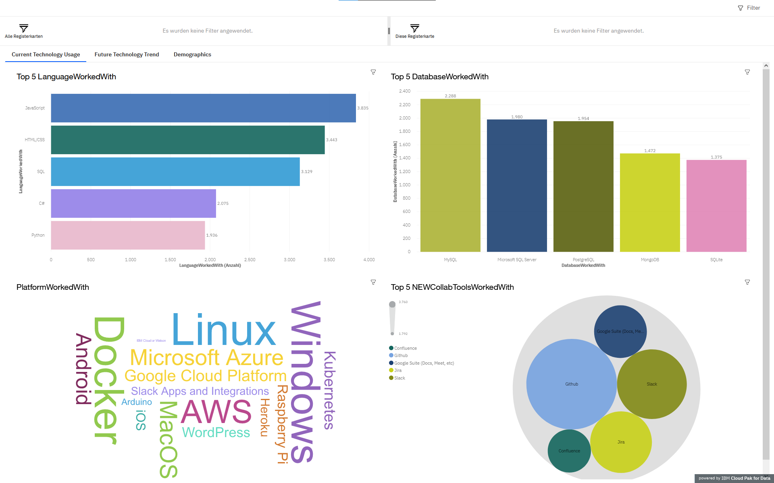
DASHBOARD TAB 1

Slide 12
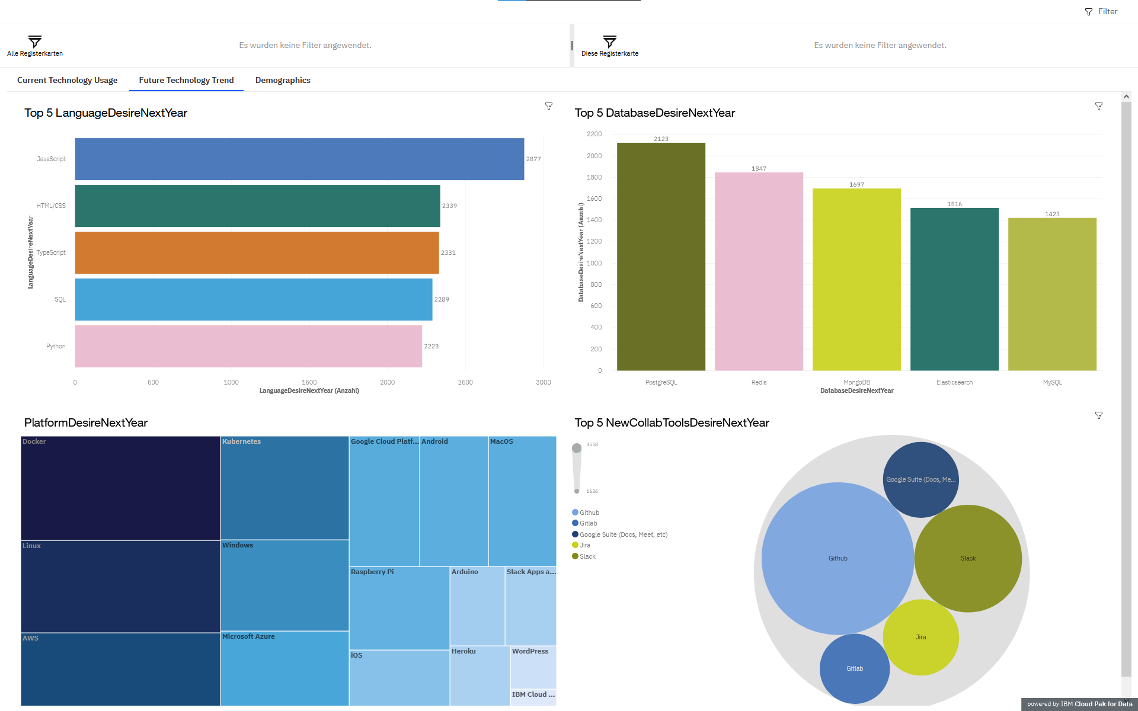
DASHBOARD TAB 2

Slide 13
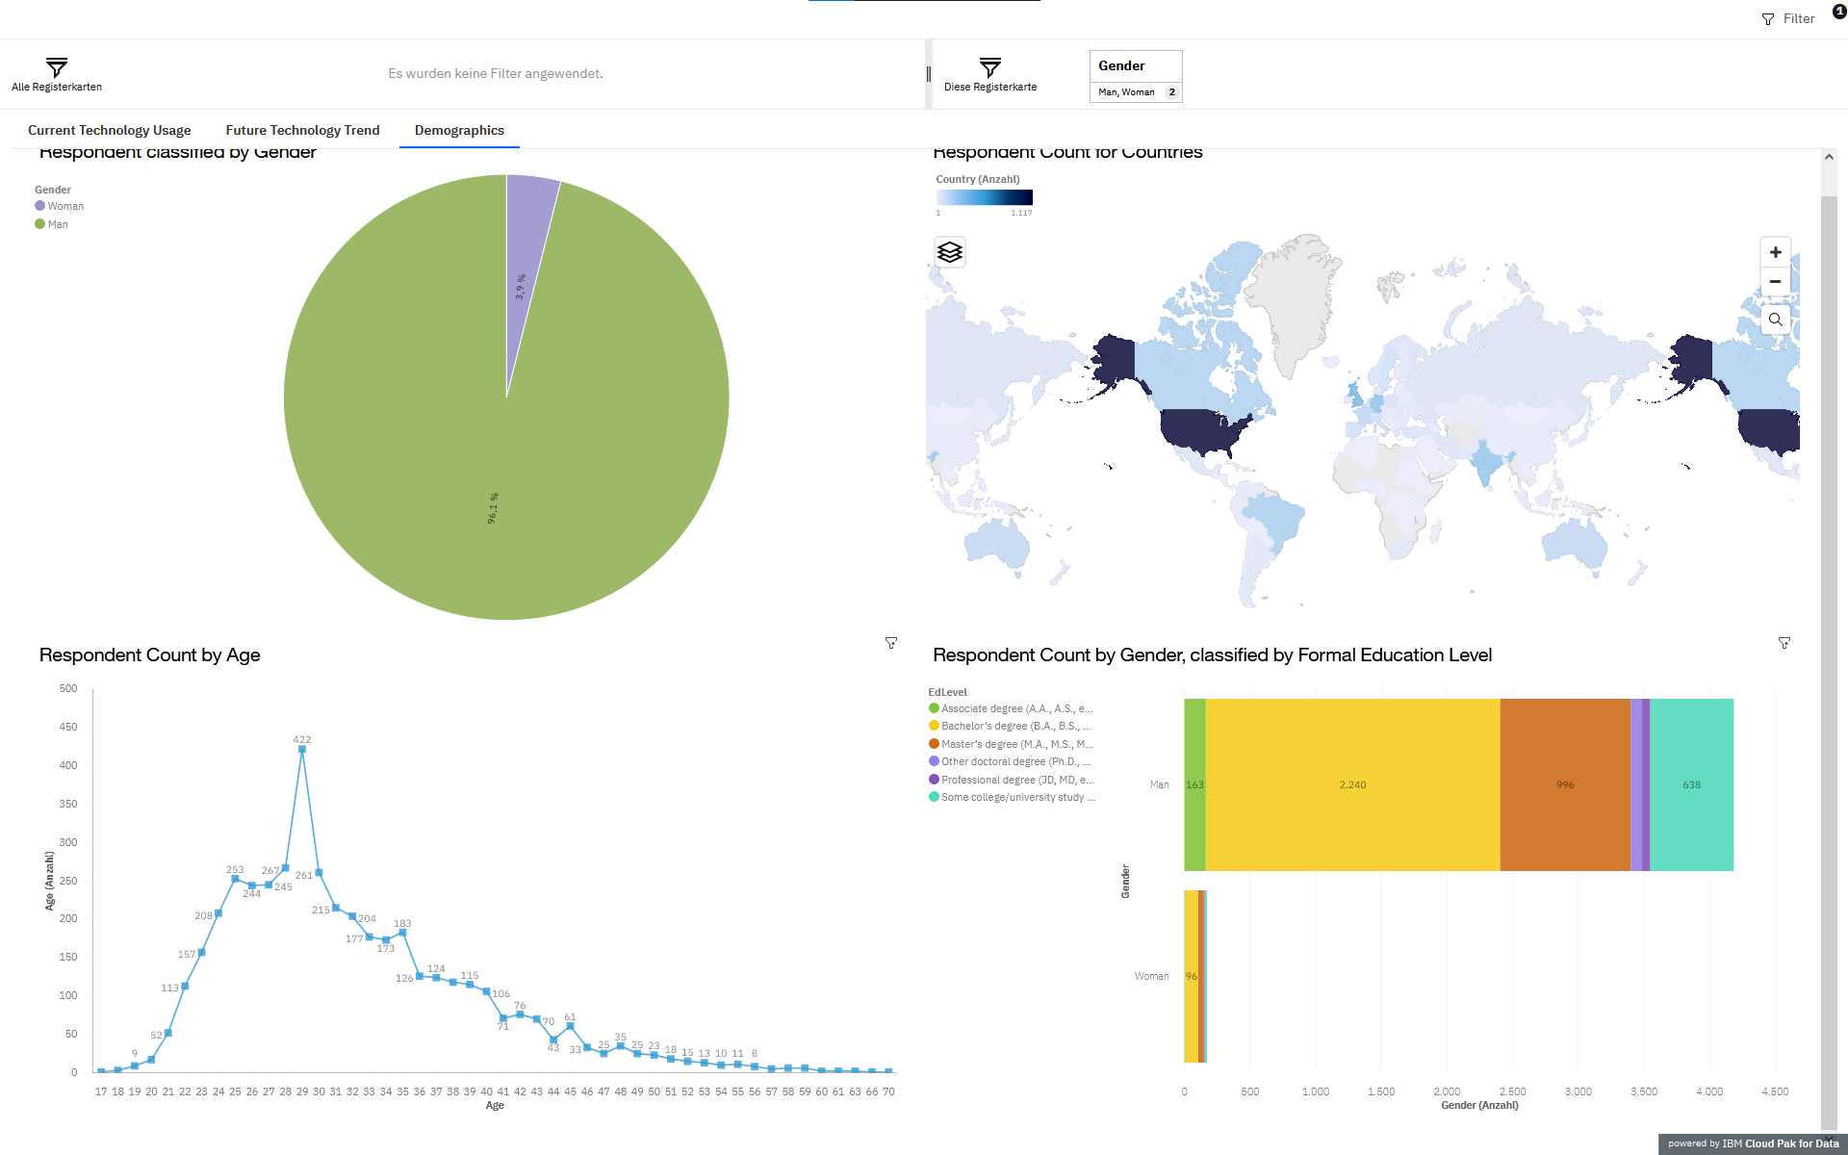
DASHBOARD TAB 3

Slide 14
DISCUSSION
TypeScript enters the Top 5 with a solid third placement
Desire for JavaScript increased
HTML/CSS, SQL and Python stays strong
PostgreSQL takes Top 1 spot for desired databases
Desire for Microsoft Server SQL and SQLite is greatly diminished

Slide 15
OVERALL FINDINGS & IMPLICATIONS
Findings
C# drops out of Top 5
C# is replaced by TypeScript
JavaScript extends its lead
PostgreSQL takes Top 1 spot
Microsoft SQL Server drops out of Top 5
Implications
Developers should not invest too much time in C#
Developers should learn JavaScript and TypeScript
Developers should learn PostgreSQL

Slide 16

CONCLUSION
Developers should learn JavaScript and TypeScript
Developers should not invest too much time in C#
Developers should learn PostgreSQL
Developers should move away from Microsoft Server SQL and SQLite

Slide 17

APPENDIX
The dataset comes from the following sources:
https://insights.stackoverflow.com/survey under a ODbL: Open Database License.
https://cf-courses-data.s3.us.cloud-object-storage.appdomain.cloud/IBM-DA0321EN-SkillsNetwork/labs/datasets/Programming_Languages.html
https://insights.stackoverflow.com/survey/2020 under a ODbL: Open Database License.
We are using a modified subset of that dataset for the assignment

Slide 18
GITHUB JOB POSTINGS

Slide 19
POPULAR LANGUAGES

